Slide 2
Ignite 2016 PPT Resource Kit

Slide 3
We are colorful
Life happens in color. Color captures passions, inspires emotions, and connects us. Bright and energetic, our colors add vibrancy. They are among our most recognizable elements. Color helps to unify our visual identity.

Slide 4
Our brand colors
Layouts should use our eight brand colors as the primary palette in communications.
Digital and on-screen applications use RGB or HEX color formulas. The color formulas are shown below.
Yellow
R255 G185 B0
FFB900
Orange
R216 G59 B1
D83B01
Red
R232 G17 B35
E81123
Magenta
R180 G0 B158
B4009E
Purple
R92 G45 B145
5C2D91
Blue
R0 G120 B215
0078D7
Teal
R0 G130 B114
008272
Green
R16 G124 B16
107C10

Slide 5
Accessibility
Type and background combinations must meet a minimum 4.5:1 contrast ratio or greater for accessibility. Examples below demonstrate correct color use for on-screen applications. Colors shown with notched corners require black/dark text to be accessible.
Light Yellow
R255 G241 B0
FFF100
Light Orange
R255 G140 B0
FF8C00
Light Magenta
R227 G0 B140
E3008C
Light Purple
R180 G160 B255
B4A0FF
Light Blue
R0 G188 B242
00BCF2
Light Teal
R0 G178 B148
00B294
Light Green
R186 G216 B10
BAD80A
Light accent colors
Yellow
R255 G185 B0
FFB900
Orange
R216 G59 B1
D83B01
Red
R232 G17 B35
E81123
Magenta
R180 G0 B158
B4009E
Purple
R92 G45 B145
5C2D91
Blue
R0 G120 B215
0078D7
Teal
R0 G130 B114
008272
Green
R16 G124 B16
107C10
Microsoft 8 brand colors
Dark Red
R168 G0 B0
A80000
Dark Magenta
R92 G0 B92
5C005C
Dark Purple
R50 G20 B90
32145A
Dark Blue
R0 G32 B80
002050
Dark Teal
R0 G75 B80
004B50
Dark Green
R0 G75 B28
004B1C
Dark accent colors (+ one mid accent color)
Mid Blue
R0 G24 B143
00188F
For more information on accessibility, visit: Microsoft.com/enable.
White
R255 G255 B255
FFFFFF
Light Gray
R210 G210 B210
D2D2D2
Mid Gray
R115 G115 B115
737373
Dark Gray
R80 G80 B80
505050
Rich Black
R0 G0 B0
000000
White, black and gray accent colors

Slide 6
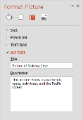
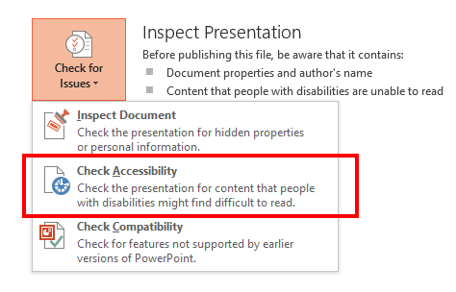
Creating accessible content
Accessibility definition
Developing an equal experience for all users that enables individuals to adjust their user experience to meet their unique visual, hearing, dexterity, cognitive, and speech needs.
4 simple ways to improve accessibility in your presentations:
Use high contrast colors for maximum readability
Recommended contrast ratio is 4.5:1
Accommodate for color blindness
Use different shapes with a legend to indicate status
Add ALT TEXT for images & pictures
This assists people who use screen readers
Use the Office 2013 Accessibility Checker
File > Check for Issues > Check Accessibility
Download Contrast Analyzer Tool
Best
Here’s how:
Right click the image
Select Format Picture
Select the Size & Position icon
Expand the ALT TEXT field
Enter a Title and Description
OK
On track
Needs work
Not on track
Not accessible
More presentation accessibility tips here
Learn more at http://enable
Notes:
On

Slide 7
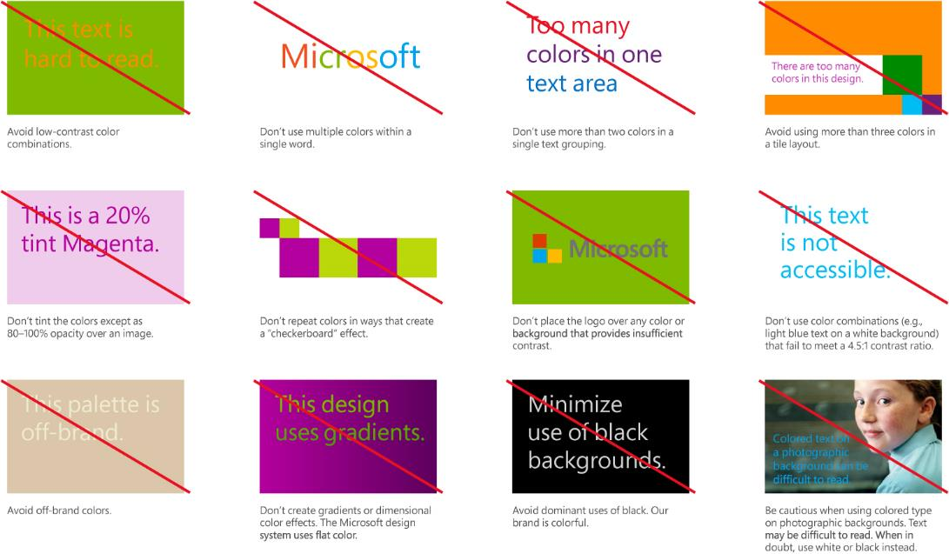

Slide 8
Grids bring structure to simplicity
The underlying structure of all Microsoft design, grids help balance your layout, creating the spacing and information organization that will guide customers to the most important visual elements and messages.

Slide 9
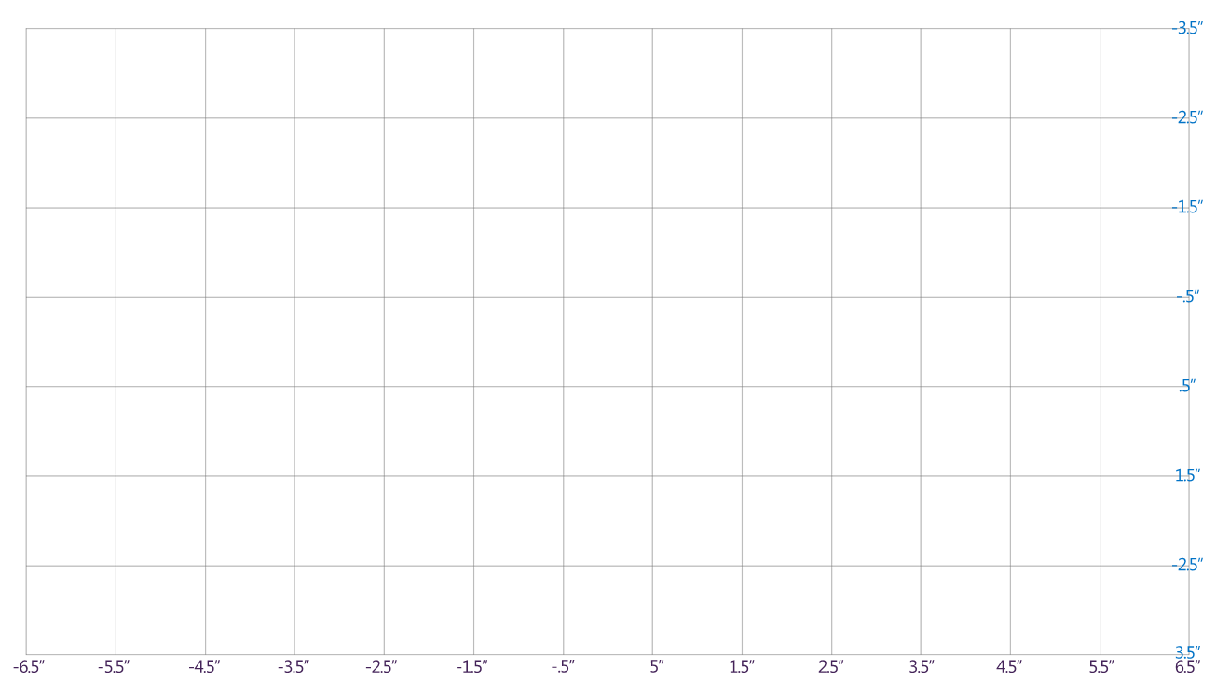
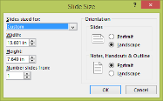
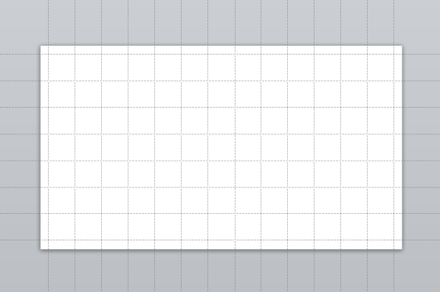
The recommended 16:9 grid
Tip: Turn off PowerPoint’s drawing guides when viewing this slide in normal view. (View menu > uncheck the box in front of Guides)
For 16:9 aspect ratio PowerPoint templates
The recommended grid for 16:9 PowerPoint templates is shown on the left. The grid is provided in .png format on the next slide
When building slides, it’s easier to use PowerPoint's drawing guides, as shown below. Content tiles can be easily snapped and aligned to drawing guides.
The PowerPoint drawing guides in this template have been positioned (as shown below), using the numeric settings shown on the left.
IMPORTANT: 16:9 slide dimensions must be set to: 13.6”w x 7.65”h (Design menu > Slide size > Custom slide size. PowerPoint will reset to the size to 13.601”w x 7.649”h – this is okay.)
13 columns
1” x 1” grid units
7 rows

Slide 10
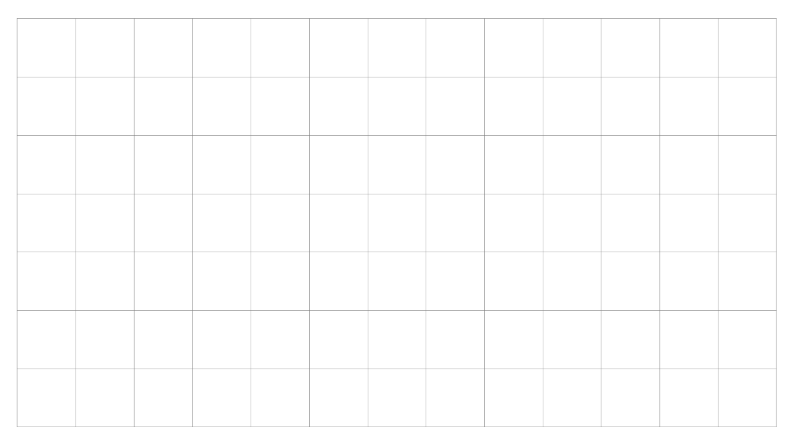
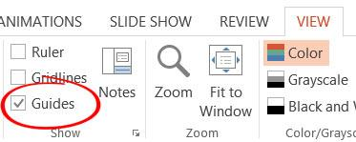
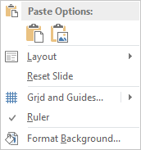
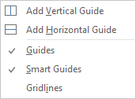
The .png grid
-3.5”
This grid on this slide is a graphic in .png format. It can be copied and pasted onto other slides, but ALWAYS remove it before finalizing the slide.
-2.5”
TRY THIS: Turn on PowerPoint drawing guides. Click on the View menu along the top, and then check the box to the left of Guides.
Notice how the guides align to this .png guide, so you don’t even need to use this graphic.
Add additional guides as you need. To add a guide, right-click on the gray area outside the slide area. From the pop-up menu, choose Grid and Guides… and then choose Add Vertical Guide or Add Horizontal Guide. A gray guide will be added in the center of the slide. Click to drag it where you want it to be positioned. To remove it, drag it off the edge of the slide.
-1.5”
-.5”
.5”
1.5”
-2.5”
3.5”
-6.5”
-5.5”
-4.5”
-3.5”
-2.5”
-1.5”
-.5”
-5”
1.5”
2.5”
3.5”
4.5”
5.5”
6.5”

Slide 11
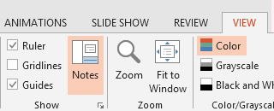
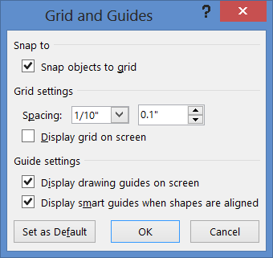
Grid and guide tips
-3.5”
-2.5”
POWER USER TIPS: Set your grid and guides as shown in the lower left picture. Then as you work, use the arrow keys to quickly nudge and align shapes to the grid.
To temporarily release the snap behavior use these shortcuts:
When nudging shapes, hold down the Ctrl key.
When resizing shapes, hold down the Alt key.
To turn off snap behavior, uncheck all boxes.
If you find the drawing guides distracting, use the View menu > Guides checkbox to quickly hide and unhide the drawing guides as you work.
The fine print. You can set the same drawing guide settings in existing 16:9 aspect ratio PowerPoint templates.
First, change the PowerPoint page dimensions to: 13.6”w x 7.65”h. (Design menu>Page Setup).
Next, on the View menu, click the tiny arrow in the bottom right corner of the Show submenu. Check the box in front of Snap objects to grid, and set the grid spacing to .1” Click OK.
Reposition the drawing guides so they align to the numeric values shown on this slide. To remove a drawing guide, click and drag it off the slide. To add a drawing guide, click on any existing guide while holding down the Control key and dragging the guide. A duplicate guide will be created.
Interior margins will also need to be set so text aligns correctly. Refer to the “Interior Margins” slide later in the deck.
-1.5”
-.5”
.5”
1.5”
-2.5”
3.5”
-6.5”
-5.5”
-4.5”
-3.5”
-2.5”
-1.5”
-.5”
-5”
1.5”
2.5”
3.5”
4.5”
5.5”
6.5”

Slide 12
Step-by-step content tiles
Tiles establish a consistent visual language across all Microsoft brand communications. Tiles form natural structures for placing type, especially on photographic backgrounds.
As useful and memorable as tiles can be, overusing them can dilute their impact and crowd your layout. Remember to employ a fierce reduction of elements and apply tiles thoughtfully.

Slide 13
Clarity & simplicity
Not all content needs to be in tiles
Type is what articulates the message
Text doesn’t need to be bulleted
Text size can reinforce and impact
It’s more than tiles
Fierce reduction of elements
Well defined hierarchy
Scale and contrast to create interest and focus
Keen attention to detail

Slide 14
Creating content tiles
While alignment with the grid is meant to bring structure, it still remains flexible by allowing you to create tiles customized for your size requirements
Design Tip: In this tutorial section, turn on the drawing guides (View -> Guides) to see how content tiles are aligned to the underlying grid system.
Use tiles only if there is content such as text or photos and not for decoration
Always align tiles or groups of tiles with the
left margin of the layout
All type should align left along the interior margin.

Slide 15
Interior margins
All type should align to the left interior margin.
Default settings for interior margins are listed below.
These default settings for text blocks and content tiles (shapes) have been set for you:
Left: .20”
Right: .20”
Top: .16”
Bottom: .16”
Text alignment: Left
Anchor: Top
Text line spacing: Multiple .9”
All text blocks and shapes use the same interior or internal margins.
In PowerPoint, internal margins for text are set in the Format Text Effects menu and for shapes in the Format Shape menu.
These default settings make it easy to align the text in content tiles and text blocks to the same interior margin, when their outer borders are aligned to the drawing guides.

Slide 16
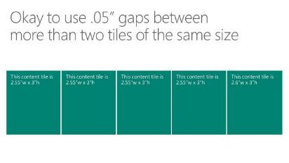
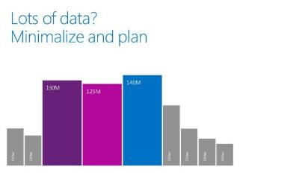
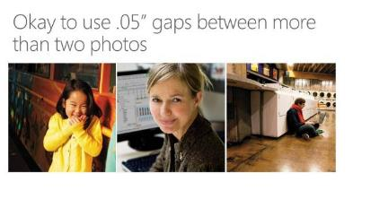
When to use gaps
Use .05” gaps between more than two tiles of the same size.
.05” gaps can be used between more than two tiles of the same size.
.05” gaps can be used in graphical layouts when it improves legibility or is necessary to separate shapes of the same color.
.05” gaps can be used between more than two photos.

Slide 17
Steps for adding gaps
Part 1
This content tile measures 3”w x 3”h
This content tile measures 3”w x 3”h
This content tile measures 3”w x 3”h
This content tile measures 3”w x 3”h
Follow these steps to quickly add space between shapes and content tiles:
Turn on the drawing guides, (On the View menu, check the box in front of Guides.)
Start with content tiles aligned to the grid as shown above (edges touching). Tiles don’t need to be square. The grid is based on 1” x 1” units, so shapes aligned to the grid be will be even inches.
Click to select the first content tile on the left, then click on the Format menu. On the far right of the Format menu, change the width to make it .05” narrower. In this example, change the width from 3” to 2.95”. Repeat the same steps for the second and third content tiles. You can select them both, to speed the process. (continued on next slide)

Slide 18
Steps for adding gaps
Part
This content tile measures 2.95”w x 3”h
This content tile measures 2.95”w x 3”h
This content tile measures 2.95”w x 3”h
This content tile measures 3”w x 3”h
Your slide should now look like this.
Leave the last content tile at 3”w x 3”h since no gap is needed on the right side. Although the first 3 boxes are slightly narrower, this slight size difference won’t be noticeable.
Notice how the .05” gaps opened on the right edges, and the left edges remained aligned to the grid. This is a quick way to create uniform .05” gaps.

Slide 19
Centered tiles
Limit the number of colors to no more than 3-4 on any one slide.
Slides with 5 or more tiles work well with one color.
13”
This content tile is 2.55”w x 3”h
This content tile is 2.55”w x 3”h
This content tile is 2.55”w x 3”h
This content tile is 2.55”w x 3”h
This content tile is 2.6”w x 3”h
Align all text blocks to the content tiles interior margins

Slide 20
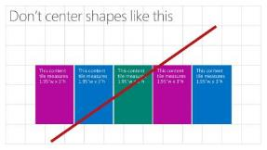
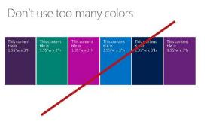
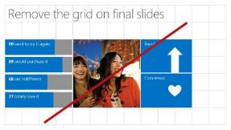
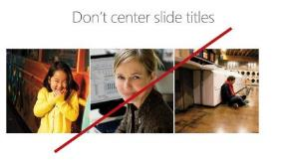

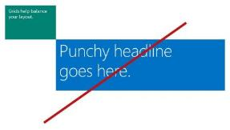



Don’t center content tiles, unless the total width equals 13”, spanning the slide from border to border.
Limit colors to no more than 3-4 on any one slide.
Don’t forget to remove the .png grid from final slides.
Keep titles aligned left.
Avoid using black content tiles. The Microsoft brand is colorful.
Don’t add tiles at 45˚ angles. They should always be added side-by-side or directly above or below the prior tile.
Don’t use tiles without text, for decorative purposes.
Don’t right-align type or objects in tiles.
Don’t middle align type. Type should be top aligned.

Slide 21

Photos tell our story
The impact of our imagery depends upon how authentically we tell our stories. With every image, we look to tell our audience of people’s passion as they realize it through the use of our technology. We’re inspired by people’s drive for life and their enthusiasm for the future.

Slide 22

Our photos are authentic, optimistic and brave
An expansive set of shared lifestyle and product photography is available for use in Microsoft communications. Avoid purchasing stock photography whenever possible.

Slide 23

When text isn’t legible on a full-bleed photo, a content tile can be used.
It can be fully opaque or 5-20% transparent.

Slide 24
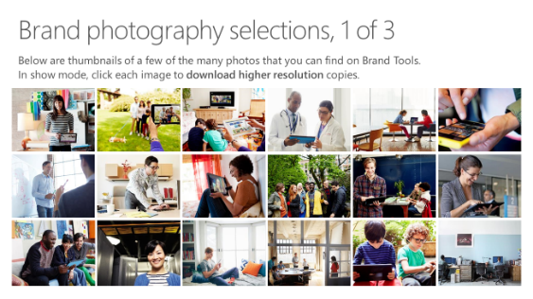
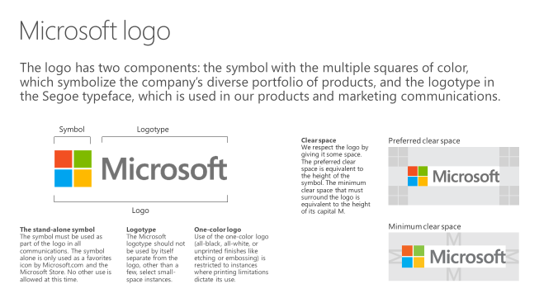
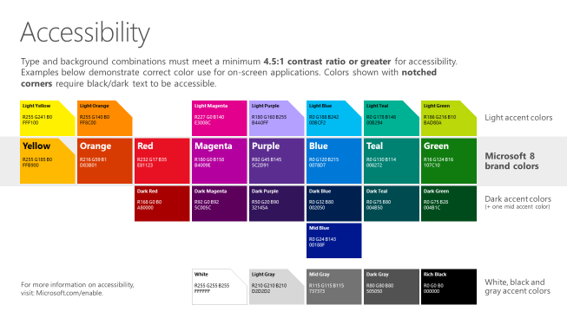
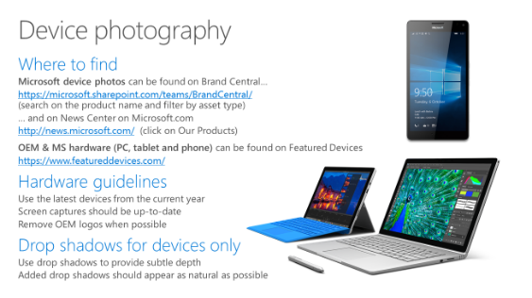
Microsoft brand guidelines
Looking for more slide resources?
Brand guidelines for PowerPoint templates is a separate slide deck that provides an overview of the Microsoft brand, guidelines, resources, tips and much more.
A few of the slides are shown at right.
Download from: https://microsoft.sharepoint.com/teams/BrandCentral/Pages/Presentations.aspx

Slide 25
Where can I find photos?
A few great places to start…
Brand Central: A resource for information on the Microsoft brand
https://microsoft.sharepoint.com/teams/BrandCentral/
Microsoft News Center A great place for the latest and greatest
www.microsoft.com/en-us/news
Xbox Wire Media Assets library
http://news.xbox.com/media
Featured Devices: PC, tablet and phone hardware imagery and marketing materials
https://www.featureddevices.com/
Presentation Resources: Presentation guidelines and PowerPoint templates
https://microsoft.sharepoint.com/teams/BrandCentral/Pages/Presentations.aspx
Respect intellectual property rights
Photography and graphics used in presentations, for both internal and external audiences, must be owned by Microsoft or licensed appropriately.
Microsoft has agreements in place with several stock providers. Contact Media Acquisitions for more information.
Media Acquisitions (mediaacq alias)
www.superstock.com/
www.gettyimages.com/creativeimages/royaltyfree
www.corbisimages.com/stock-photo/royalty-free
Send selections to: ImageAcq@microsoft.com.
Avoid intellectual property theft: Do not use photos or graphics copied from the web in presentations. When in doubt, consult with LCA http://lcaweb/CTP/Copyrights/Third-Party-Content-Use/Pages/default.aspx

Slide 26


















Brand photography selections, 1 of 3
Below are thumbnails of a few of the many photos that you can find on Brand Central.
In show mode, click each image to download higher resolution copies.

Slide 27


















Brand photography selections, 2 of 3
Below are thumbnails of a few of the many photos that you can find on Brand Central.
In show mode, click each image to download higher resolution copies.

Slide 28


















Brand photography selections, 3 of 3
Below are thumbnails of a few of the many photos that you can find on Brand Central.
In show mode, click each image to download higher resolution copies.

Slide 29


Device photography
Where to find
Microsoft device photos can be found on Brand Central
https://microsoft.sharepoint.com/teams/BrandCentral/
OEM & MS hardware (PC, tablet and phone) can be found on Featured Devices
https://www.featureddevices.com/
Hardware guidelines
Use the latest devices from the current year
Screen captures should be up-to-date
Remove OEM logos when possible
Drop shadows for devices only
Use drop shadows to provide subtle depth
Added drop shadows should appear as natural as possible

Slide 30


Photos and a tile
Photos and tiles can be combined. Edges should touch.
Align text to upper left corner
Content tiles (which must always have text) work well between photos
Use soft gradients behind text when needed to increase legibility

Slide 31



Photos separated by gaps
Design Tip: Turn on the drawing guides (View -> Guides) to see how content tiles are aligned to the underlying grid system.
It’s permissible to add 05” gaps between photos when doing so helps the photos read better.
This photo measures 3.95”w x 4”h
This photo measures 3.95”w x 4”h
This photo measures 4”w x 4”h
This text shape has no fill. It uses the same default interior margins as content tiles
Align all text blocks to the content tiles interior margins
Text can be used on, above or below photos.

Slide 32
Our illustrations are engaging, active, and vivid

Slide 33



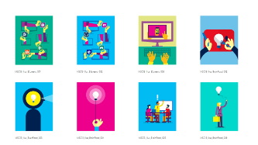
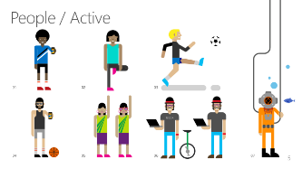
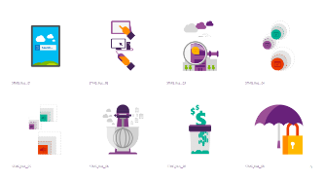
Illustration resources and guidelines
3 PowerPoint decks with illustrations:
Download from Brand Central:
https://microsoft.sharepoint.com/teams/BrandCentral/
Corporate collection
Microsoft.com collection
Cloud & Enterprise collection

Slide 34
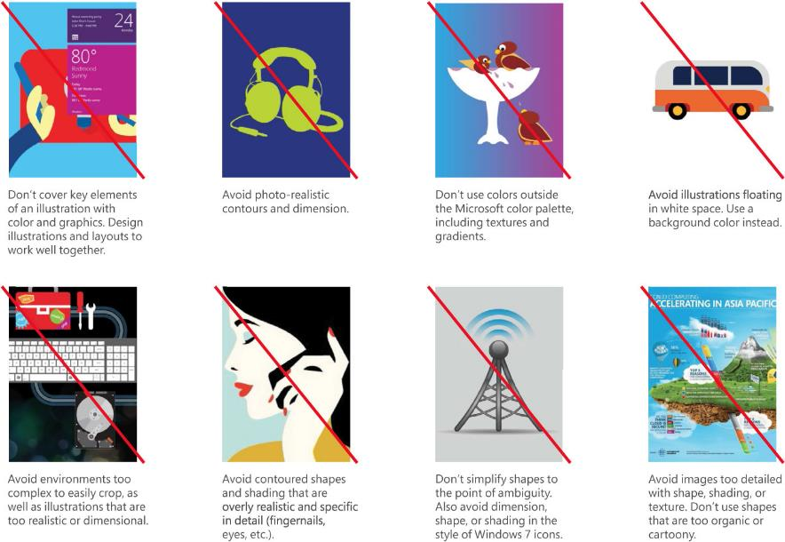
What to avoid when using or producing Microsoft illustrations:
Avoid decorative illustrations without an informational purpose
Avoid photo-realistic or 3D style
Avoid static illustrations
Avoid cartoony illustrations
Avoid textures and gradients
Avoid complex environments that make cropping difficult
Avoid floating images over white backgrounds
Avoid images that are not flat
Avoid contoured shapes, shading and texture
Avoid shapes that are too detailed or specific
Don’t be simplistic or juvenile
Avoid illustrations that are too organic

Slide 35
Illustration showcase

Slide 36




Apps for everyone

Slide 37
Sample content with illustration

Slide 38

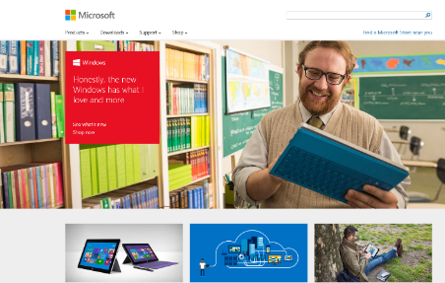
Get started http://www.microsoft.com

Slide 39
Morning break

Slide 40
Sample content with illustration

Slide 41



Custom illustrations
The designers at Silver Fox Productions are experts at creating custom illustrations for speakers.
If you are in need of a custom illustration, Silver Fox can help. Please email Ignite@silverfoxprod.com. We can create custom illustrations to convey your message. Please note that the cost of conceptualization and creation of any illustrations will need to be covered by the speaker and their budget.

Slide 42
All about icons
Simple and direct, an icon condenses a message into its simplest form. Less is more. Icons make it easier for consumers to recognize identical functions, or call to actions, in different contexts.

Slide 43
Icons

Slide 44
Icons

Slide 45
Layered world map
See next slide for instruction on how to customize this fully editable map.

Slide 46
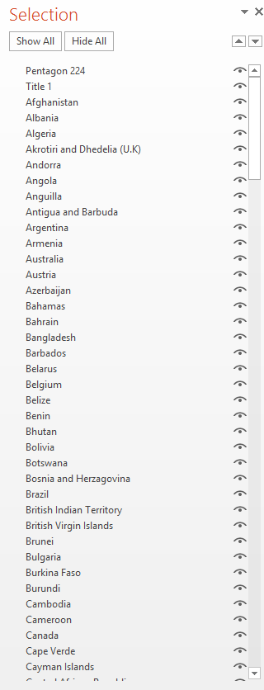
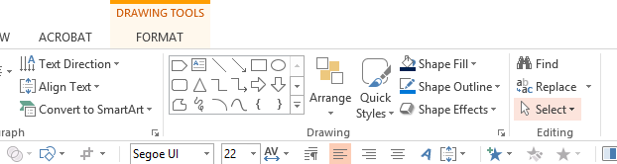
The selection pane
Much like a layers palette, PPT has a selection pane. We can utilize this to select objects in multi-layered slides. When building multi-layered slides be sure to name your layers for efficiency.
To find the selection pane, navigate to the ribbon at the top of the program.
Select the “Home” tab.
To the far right you will see the “Select” dropdown menu.
Click that and choose “Selection pane.”
A menu will pop up to the right in the same general location as the format shape menu appears.
This is your selection pane.
This is the selection pane from the previous slide. You can easily select countries and recolor them to customize your map slide for your presentation.

Slide 47
Alignment tools
Alignment tools are a great way to align most any objects with each other or the slide itself.

Slide 48
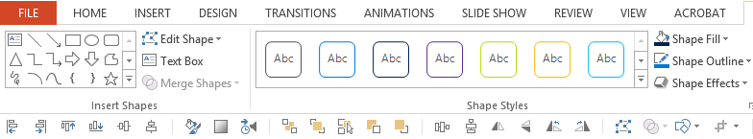
Easy to use alignment tools
These are your alignment tools in your quick access toolbar.
Using the alignment tools, see if you can make the left set of tiles look like the right set. (Hint: Define your top, bottom, left, and right corners.)

Slide 49
Quick photo transparency
Let’s explore a quick way to make a picture transparent within PowerPoint without even opening another program.

Slide 50
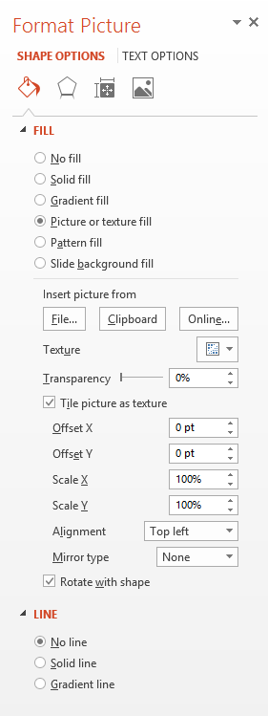
Quick & easy photo transparency
We cannot change the transparency of an image in PPT, but we can a shape. If we fill the shape with an image we can change it’s transparency by tricking the program.
Place a shape on the slide that is the desired size of the image you would like to use.
Right click on the shape and hit “Format shape.” The format shape palette will pop up to the right.
Under the “Fill” dropdown, click “Picture or texture fill.”
Next, hit the “File” button in the “Insert picture from” section.
Navigate to the image located on your machine, select it and hit “Open.”
You will recognize the transparency slider is active and you can customize the images opacity from 100% all the way down to 0%.
We can also play with the images position in the shape by using the offset & scale options.

Slide 51
Shape combine tools
In PowerPoint there are 5 different options in the shape combine tools drop down menu to choose from. They are Union, Combine, Fragment, Intersect, and Subtract.

Slide 52
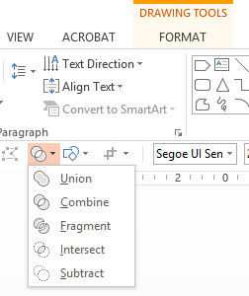
Shape combine 101
In our quick access toolbar there is a shape combine dropdown menu.
UNION: This option combines the selected pieces into one shape. (Hint: The shape that is selected first will be the shape the tool takes all formatting from. Color, text, etc.)
COMBINE: This option unites the two shapes, but the sections of the shapes that intersect disappear.
FRAGMENT: This option will take the shapes that are selected and portion them at their intersection points.
INTERSECT: This option will leave you with only the overlapping section or sections of shapes selected.
INTERSECT: This option allows one to subtract one shape from another.
(Hint: The shape that is selected first will be the shape the tool subtracts the other shape from.)

Slide 53
Eyedropper tool
Easily select Microsoft brand colors from the palette off-slide to the right.

Slide 54
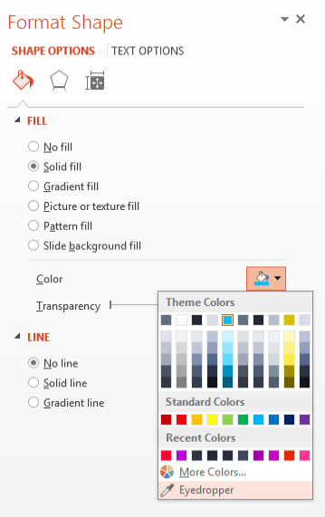
Where is the eyedropper tool?
The eyedropper tool can be found in many places throughout the PowerPoint UI, but the most readily available place is within the format shape menu.
Right click on any shape.
Click “Format shape.”
The menu will default to “Shape Options” and “Fill & Line,” as you see in the screen cap to the right.
With the shape selected, go to the “Fill Color” drop down and at the very bottom of that menu you will see the eyedropper tool.
Hover over any color on the palette on the right or any shape, picture, or text on the slide and click. Your shape will change to the exact RGB of the sampled graphic.

Slide 55
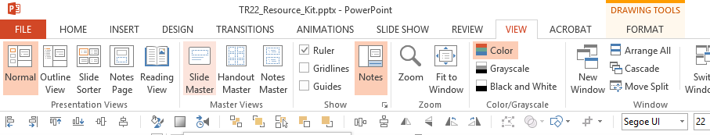
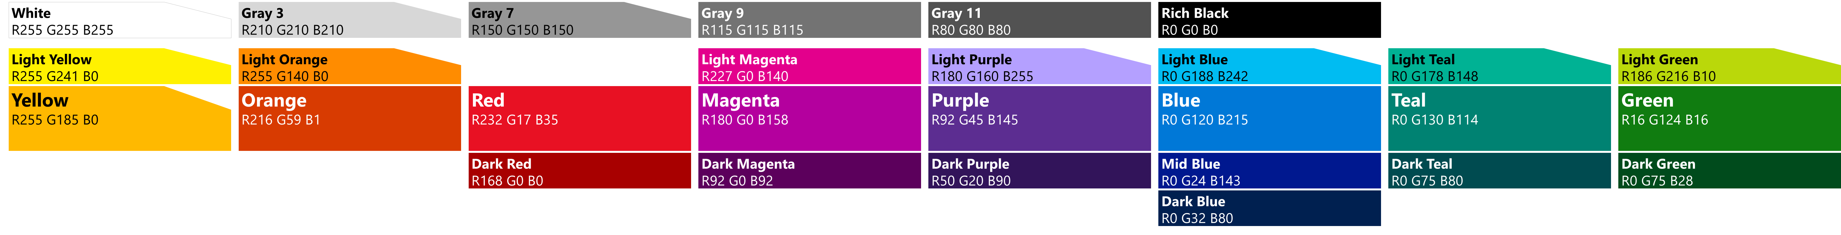
Adding the color palette to your deck
The color palette off-slide to the right is something that now comes standard when Silver Fox builds templates. In the event that this is not present in the slide deck you are working through, it is fairly simple to add so that it is visible on every slide in the off-slide area.
Copy the .png image below.
Go into the slide master view.
Paste the .png anywhere off-slide.
By pasting it in the master we can ensure it will show up on every slide without having to re-paste slide-by-slide.

Slide 56
Reducing PPT file size

Slide 57
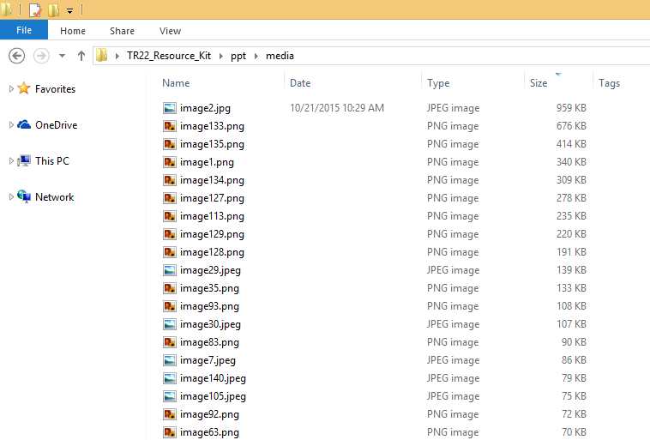
Steps for reducing PPT file size PART 1
Make a copy of the slide deck.
Change the file extension from .pptx to .zip.
Extract the .zip file.
Once extracted, navigate to the media folder. PPT > MEDIA.
Change the view of the folder to details.
Just above the files you will see column headers, navigate to the size column.
Sort the files from largest to smallest.
Now you can identify the largest images and go into the actual deck and reduce the image resolution.

Slide 58
Steps for reducing PPT file size PART 2
There are a couple ways we have found you can reduce the resolution of images quickly and easily.
The main go-to method is the Compress Picture tool.
There is also cutting the image and pasting special. This is mainly to change the image type from a .png or .tif to a .jpg right in PPT.
The trick is to not reduce the resolution so much, as to destroy the integrity of the photo. We don’t want to make it too blurry or pixelated and distract from your message.

Slide 59
Steps for reducing PPT file size PART 3
If after completing parts 1 & 2 you still have a bit of an unmanageable file size, you may need to look in the template master.
Many times when compiling a deck from many different sources, there can be residual pieces left within a PPT file. The most common and most problematic are old unused template masters. These tend to take up a ton of space and bloat the deck.
Go into the template master and delete all unused masters to reduce the size of your file even more.

Slide 60
Animations & transitions
Animations and transitions are tools that assist in effectively telling your story. They can help to explain a step-by-step process, illustrate a timeline, and create interest to support what you’re saying.

Slide 61
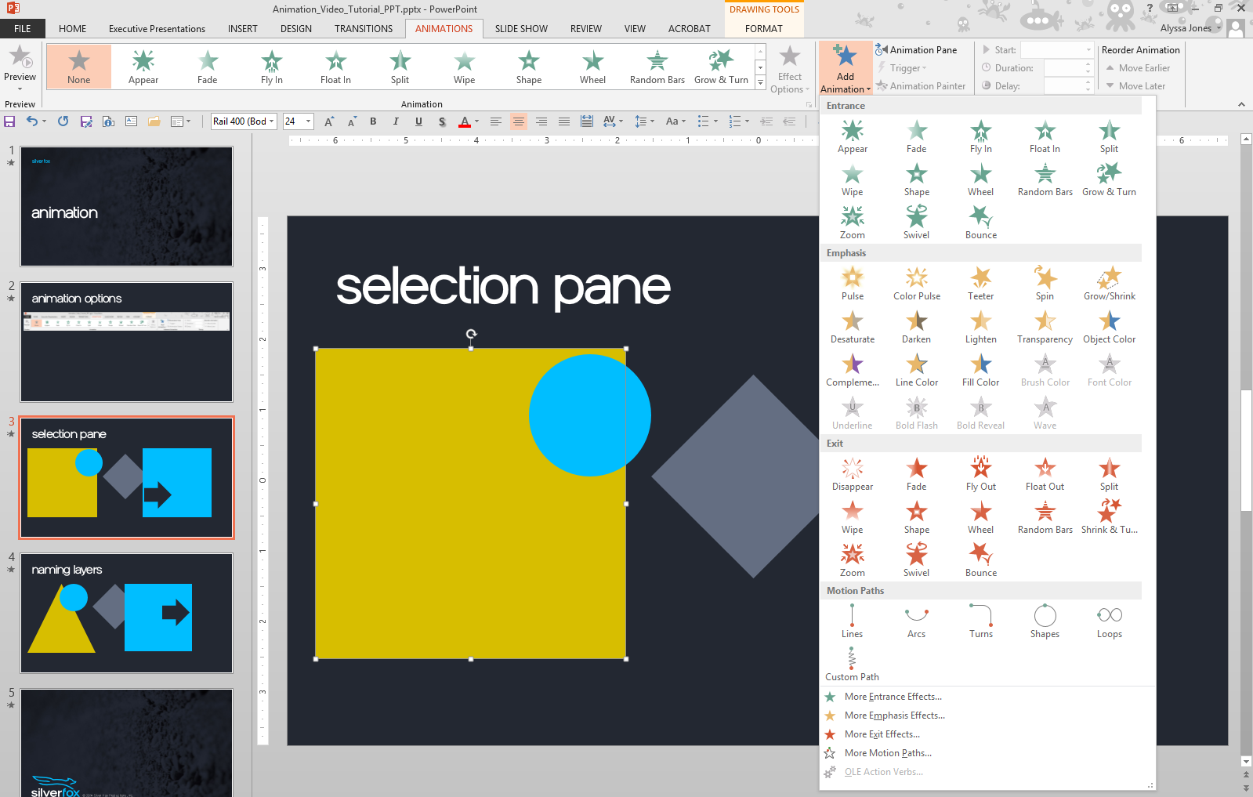
Animation options
The four options of animation are:
Entrance animations (green) which describe the animations that bring an object onto the slide.
Exit animations (red) which describe the animations that take an object off the slide.
Emphasis animations (yellow) which effect objects but don’t bring them in or move them off the slide.
Motion Paths (line) move the object around the slide. In addition to speed, motion paths also have “easing” which describes how quickly the object begins or ends moving.

Slide 62
Animation options
It’s best to always add animations using the Add Animation button in the ribbon.
This makes it possible for one object to have multiple animations added to it.
They will be added in the order that you select them, but you can change this order at any time.

Slide 63
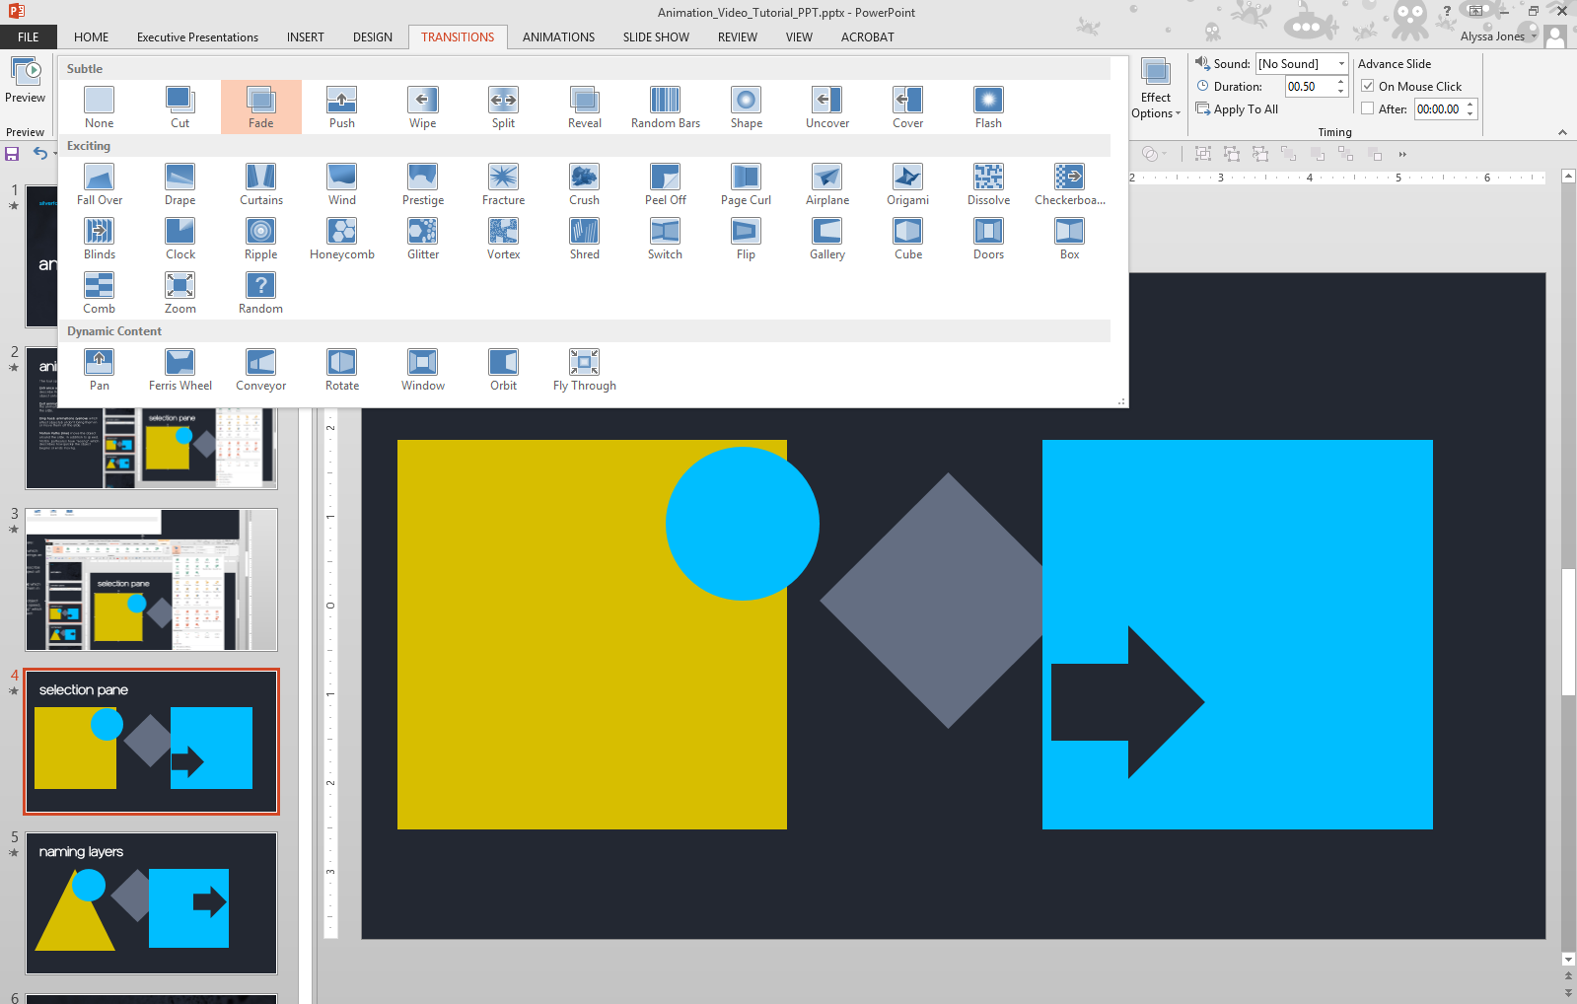
Transition options
Transitions in PowerPoint are treated very similarly to animations.
You can think of them as animations that play between slides. Just like animations, transitions have their own tab in the ribbon at the top. Also, like animations, transitions are grouped into three categories: subtle, exciting, and dynamic content.
To apply a transition, click on the slide and then click on the transition you want applied to that slide. It is worth noting that transitions are always applied to the beginning of the slide they are applied to. For instance, if you set a “fade” transition on a slide, the previous slide will then fade into the slide to which you applied the transition.
The most commonly used transitions are fade, push, pan, and reveal.

Slide 64
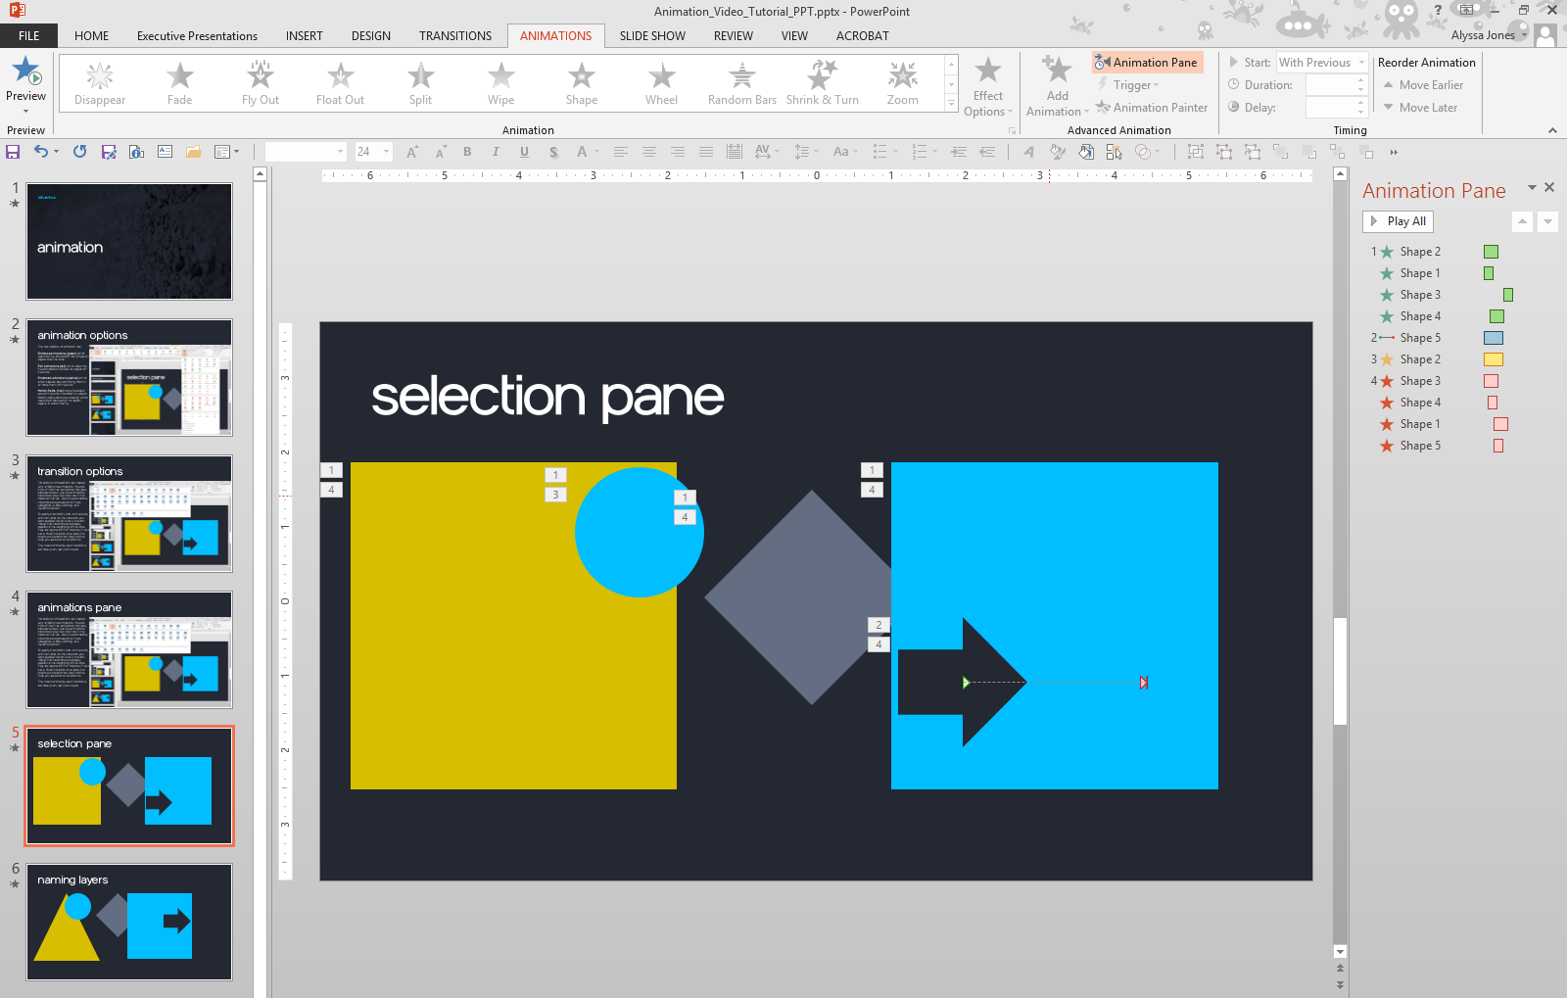
Animation pane
The Animation Pane will give you a detailed view of all the animations happening within your slide.
This includes the slide element's name, the duration of its animation, and when the animation will start.

Slide 65
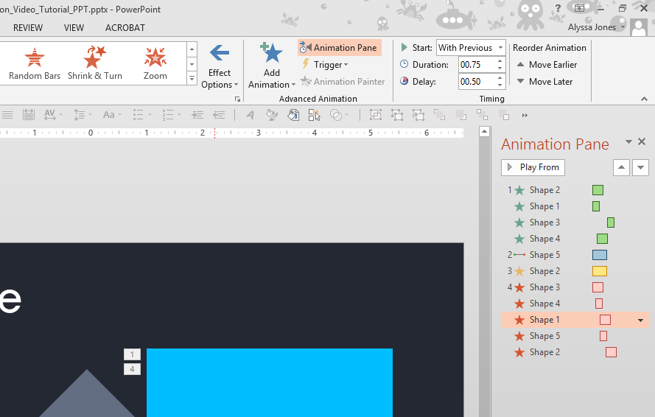
Timing
START
All animations can be told to happen “on-click”, “after previous”, or “with previous”. These presets regulate whether an animation will play with the animation directly above it in the animation pane, after the animation above it, or whether it will need to be started manually.
DURATION
The duration of an animation will control the speed at which it is completed. It is important to note that the speed of an entrance and exit animation is measured by the distance the slide element is from the edge of the slide. When entering a duration, you can use the up/down arrows which work in increments of .25 seconds, or you can manually enter a time.
DELAY
It is often helpful to use this option when combining animations. The "after previous" start selection can be too long of a delay and so playing "with previous" and adding a slight delay can allow for the desired effect.

Slide 66
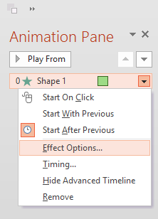
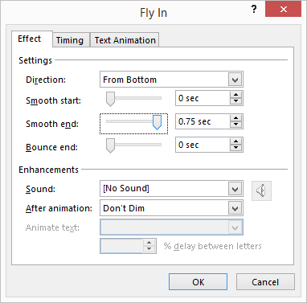
Easing
One important element that we add to our animations is an ease.
Easing helps shapes end an animation smoothly, gliding to a stop rather than coming to an abrupt hard stop. This can also be used when combining animations to allow a smooth transition. To add an ease to your animation open the animation pane and right click on your animation. Select Effect Options.
Move the Smooth end bar all the way to the right. Your shape will now glide to a stop.

Slide 67
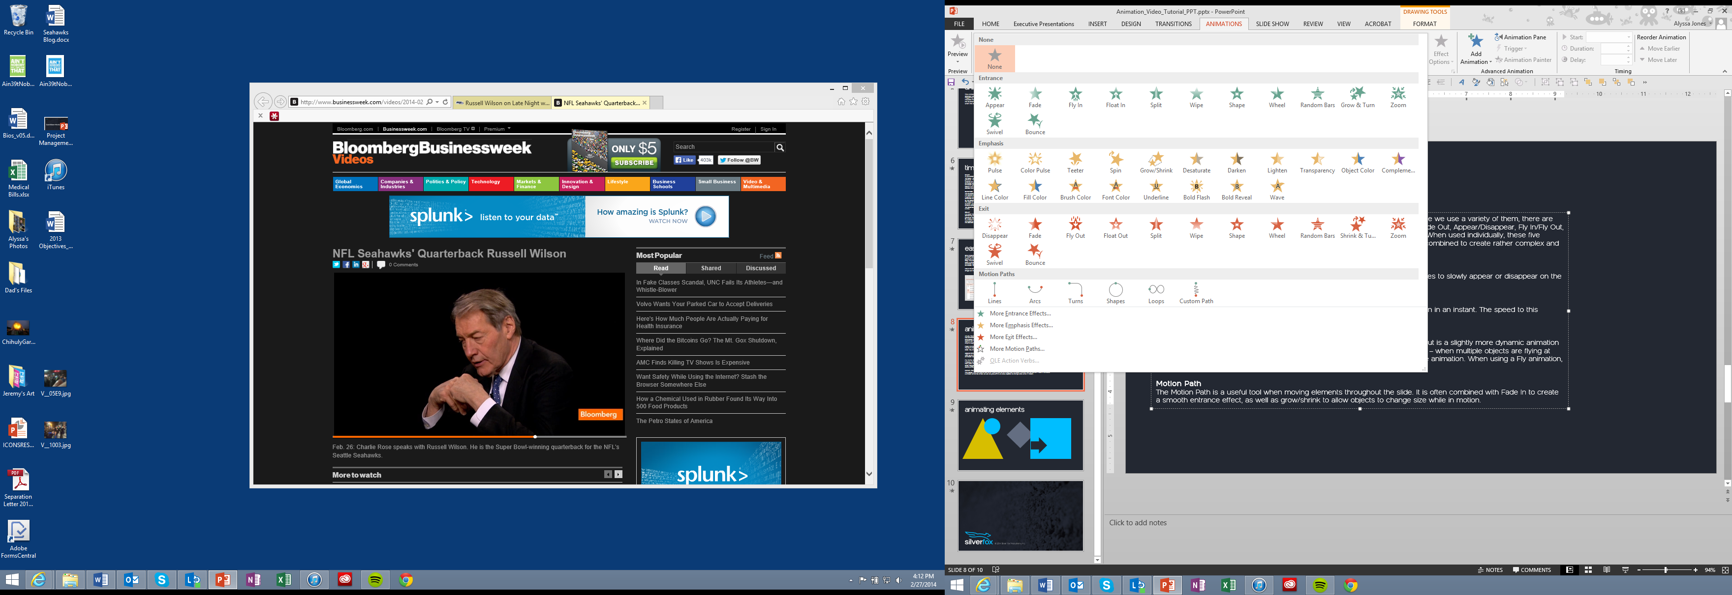
Animations
As you have learned, there are several animation options within PowerPoint.
While we use a variety of them, there are five animations we use most often—both individually and collectively. Fade In/Fade Out, Appear/Disappear, Fly In/Fly Out, and Motion path, are the five more versatile animations PowerPoint has to offer. When used individually, these five options can provide simple and elegant slide animations—but they can also be combined to create rather complex and original experiences.
Fade In/Fade Out: Found in the entrance and exit animation sections—these options allow for shapes to slowly appear or disappear on the slide. You are able to adjust their speed and timing in the animation pane.
Appear/Disappear: Also found in the entrance and exit animation sections—these animations happen in an instant. The speed to this animation cannot be edited—only delayed.
Fly In/Fly Out: Probably one of the most common entrance and exit animations, the Fly In/Fly Out is a slightly more dynamic animation than just a fade. The timing of a Fly animation is very important for optimal effect—when multiple objects are flying at once, staggering the speed and delay can add an additional layer of polish to the animation. When using a Fly animation, easing should always be applied.
Motion Path: Useful tool when moving elements throughout the slide. It is often combined with Fade In to create a smooth entrance effect, as well as grow/shrink to allow objects to change size while in motion.

Slide 68
Vertical slide starters

Slide 69
Five column
Header
Header
Header
Header
Header
Descriptor text here
Descriptor text here
Descriptor text here
Descriptor text here
Descriptor text here

Slide 70
Four column
Header
Header
Header
Header
Descriptor text here
Descriptor text here
Descriptor text here
Descriptor text here

Slide 71
Three column
Header
Header
Header
Descriptor text here
Descriptor text here
Descriptor text here

Slide 72
Two column
Header
Header
Descriptor text here
Descriptor text here

Slide 73



Three photo layout with tile
Body text here
Body text here
Body text here

Slide 74
Roadmap/timeline layout
MONTH
MONTH
MONTH
MONTH
MONTH
MONTH
<HEADER>
Subtext
Subtext
Subtext
Subtext
Subtext
<HEADER>
Subtext
Subtext
Subtext
Subtext
Subtext
<HEADER>
Subtext
Subtext
Subtext
Subtext
Subtext
<HEADER>
Subtext
Subtext
Subtext
Subtext
Subtext
<HEADER>
Subtext
Subtext
Subtext
Subtext
Subtext
<HEADER>
Subtext
Subtext
Subtext
Subtext
Subtext

Slide 75
Five column layout with icons
<HEADER>
Descriptor text here
<HEADER>
Descriptor text here
<HEADER>
Descriptor text here
<HEADER>
Descriptor text here
<HEADER>
Descriptor text here

Slide 76
Horizontal slide starters

Slide 77
Three row layout with icons
First Point
Detail
Second Point
Detail
Third Point
Detail

Slide 78

Three rows with photo
First Point
Detail
Second Point
Detail
Third Point
Detail

Slide 79
Four row layout with icons
First point
Detail
Second point
Detail
Third point
Detail
Fourth point
Detail

Slide 80

Four rows with photo
First point
Detail
Second point
Detail
Third point
Detail
Fourth point
Detail

Slide 81
Five row layout with icons
First point
Detail
Second point
Detail
Third point
Detail
Fourth point
Detail
Fifth point
Detail

Slide 82

Five rows with photo
First point
Detail
Second point
Detail
Third point
Detail
Fourth point
Detail
Fifth point
Detail

Slide 83
Sample charts & tables

Slide 84

Clean and modern
80 want to try it again
89 would purchase it
68 are indifferent
77 totally love it

Slide 85
Lots of data? Minimalize and plan
Gray is used to de-emphasize data that is less important. Use cool gray 3 or cool gray 7. See slide 7 for color formulas.
All elements have the same interior margins as text blocks.
When a chart or graphic, has more elements than can easily be aligned to the grid, align the outer edges of the group, top, bottom, left and right edges to the grid.
It is preferable to keep the group aligned to the left border.
130M
140M
125M
Other
Other
Other
Other
Other
Other

Slide 86
Pie chart 1

Slide 87
Pie chart 2

Slide 88
Horizontal bar chart
Label 1
Label 2
Label 3
Label 4
Label 5

Slide 89
Line chart
Label 1
Label 2
Label 3

Slide 90
Chart example

Slide 91
2 column table Tables are easy to modify
Text | Text
Text | Text
Text | Text
Text | Tip: To quickly add a row, place cursor in this last cell and hit Tab key

Slide 92
3 column table Tables are easy to modify
Table header | Table header | Table header
Text | Text | Text
Text | Text | Tip: To quickly add a row, place cursor in this last cell and hit Tab key

Slide 93
4 column table Tables are easy to modify
Table header | Table header | Table header | Table Header
Text | Text | Text | Text
Text | Text | Text | Tip: To quickly add a row, place cursor in this last cell and hit Tab key

Slide 94
More tables…
 | Header 1 | Header 2 | Header 3
Row 1 | Text | Text | Text
Row 2 | Text | Text | Text
Row 3 | Text | Text | Text
Row 4 | Text | Text | Tip: Place cursor in last cell and hit Tab key to add a row

Slide 95
More tables…
 | Header 1 | Header 2 | Header 3 | Header 4
Row 1
Row 2
Row 3
Row 4

Slide 96
Color map
 | FY13 | FY14 | Overall
US
Canada
LATAM
UK
Germany
France
WE
CEE
MEA
Japan
APAC
GCR
India

